Slide 1
The Future in Power Protection
Sicon Chat Union Electric Co.,Ltd | SCU Power Systems B.V.

Slide 2

Product Portfolio

Slide 3
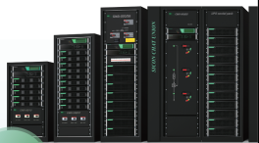
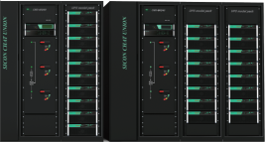


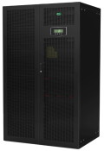

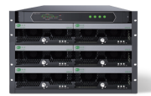

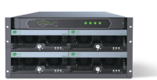


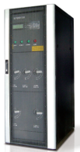
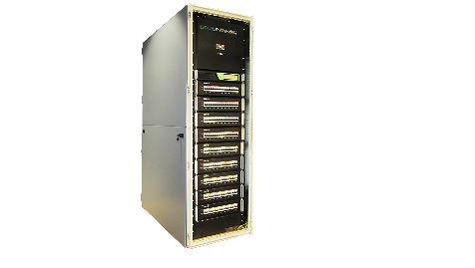
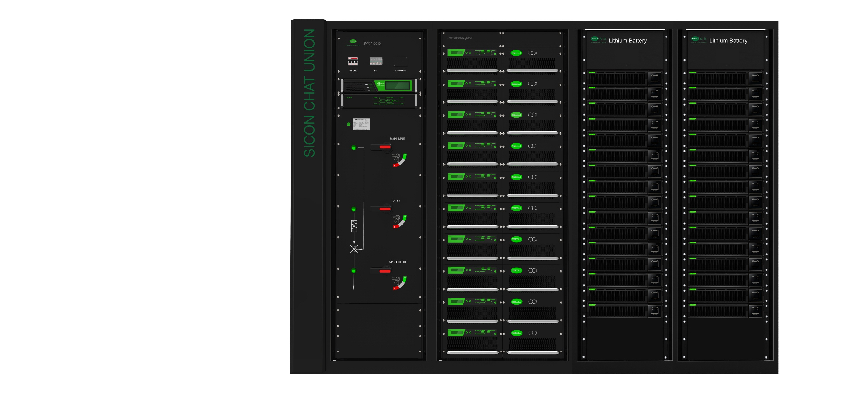
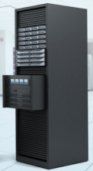
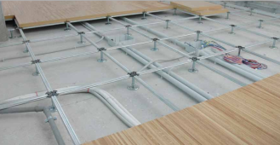

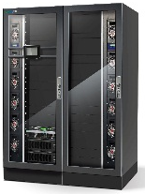
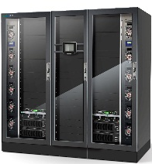
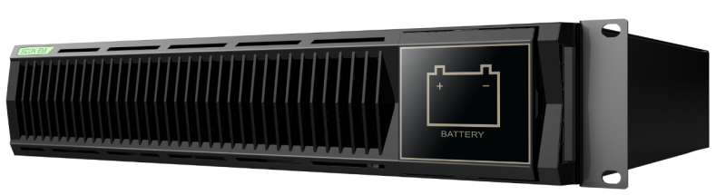

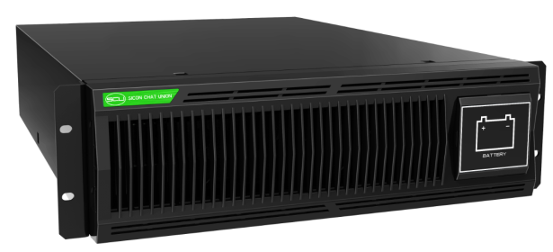

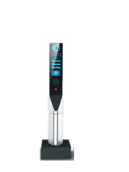
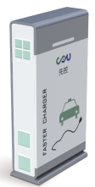
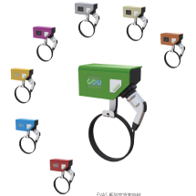

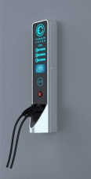

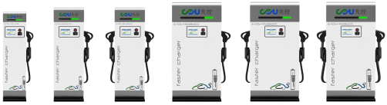

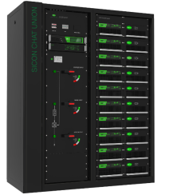
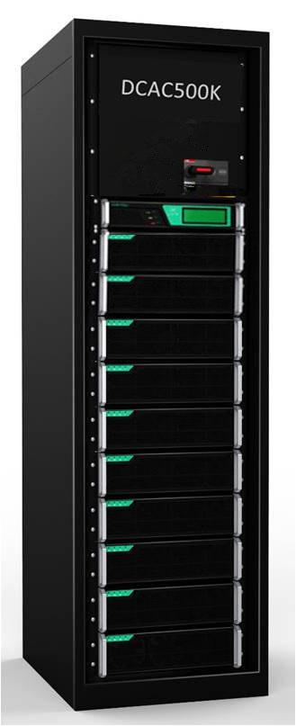

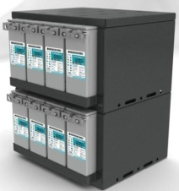
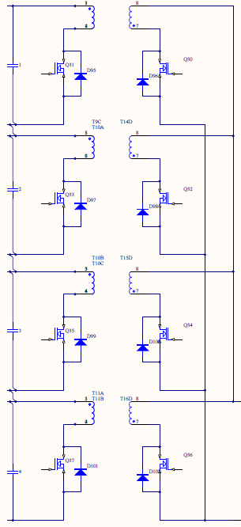





Product lines
1
UPS
UPS
1
Data Center
UPS power distribution
inverter
raised floor
micro datacenter
2
EV/charger
DC Fast-chargers
AC&DC charging station
home AC charging station
commercial AC charging station
on-board charger
3
Energy Storage
Bidirectional storage power supply
Bidirectional power converter
energy storage system
battery management system

Slide 4

Datacenter Products

Slide 5

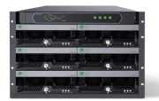
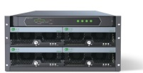
Data Center Products
1
UPS
modular CMS UPS
embedded ERMS UPS
DSM digital UPS
DSP rack mount UPS
2
UPS power distribution
static transfer switch
Smart PDU
3
inverter
inverter

Slide 6
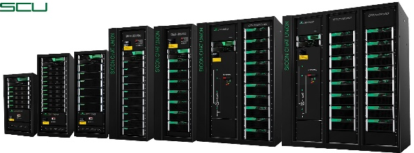
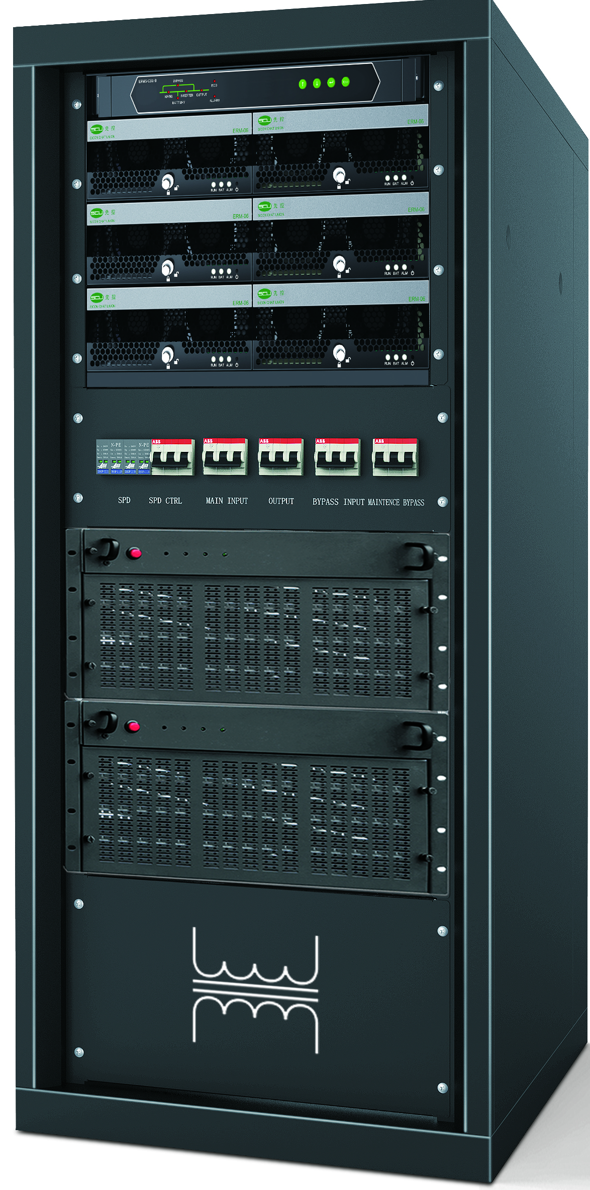
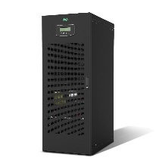
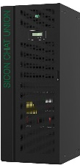
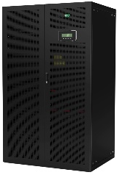
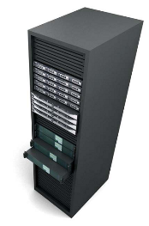
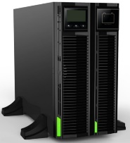
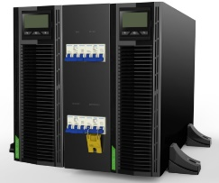
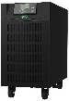
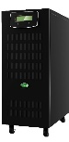
Uninterruptible Power Supply
UPS
modular UPS
high freqency digital UPS
Rackmount UPS
CMS
ERMS
DSM
DSP
DC voltage：±384
power range：50~800KVA
module power：10K、25K、40K、50K
input/output mode：33,31,13,11、
DC voltage：±240
power range：12~36KVA
module power：6K
input/output mode：31,11
DC voltage：±240
power range：20~500KVA
nput/output mode：31,11,13,33
DC voltage：±240
power range：10~20KVA
input/output mode: 11, 13, 33, 31

Slide 7
CMS
series modular UPS
Application: IDC date center, government, telecom, bank, security, transportation, broadcast&TV network, HealthCare, Communication, E-business, Finance, etc.
CMS UPS units are non-isolated, industrial level, green UPS, adopting advanced modular power protection concept. It delivers the best combination of rectifier, filter, charger, inverter and intelligent power protection. Applying innovative current sharing rectifier control, master-slave synchronization in sequence control, multi-level decentralized control and 3-level sine wave modulation technology, it features great proven efficiency, flexibility and reliability.

Slide 8
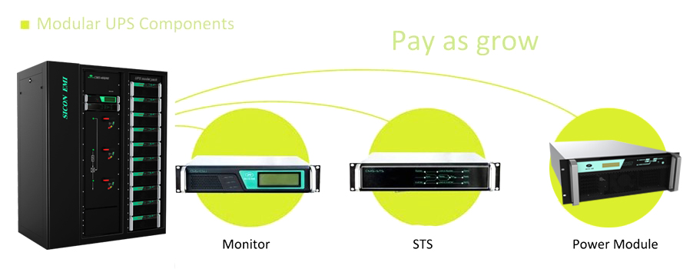
Modularized system
All electronic parts are installed in the module, All modules are hot-swappable.
Optimization of investment + Optimization of configuration

Slide 9
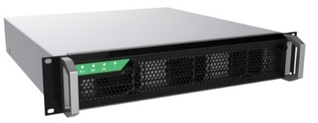
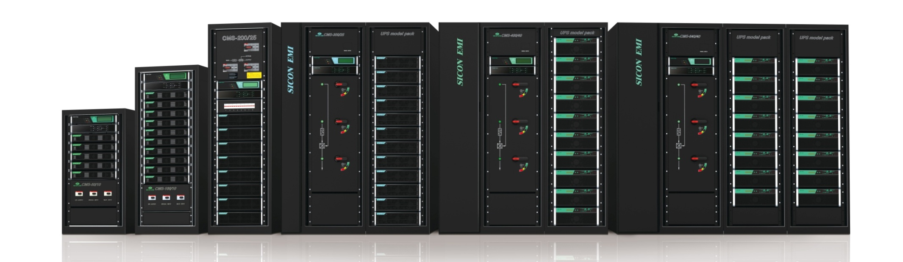
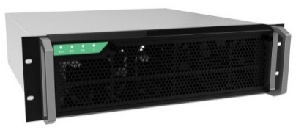
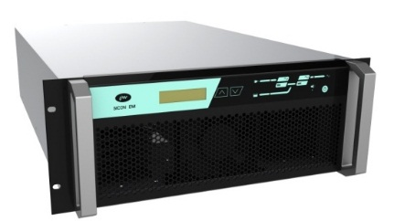
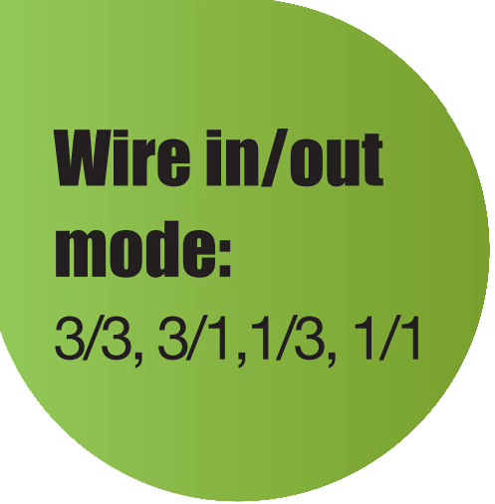
Standard design
10kVA
25kVA
CMS-50
CMS-100
CMS-200
CMS-300
CMS-400
CMS-640
40kVA
Standardized, modular, high-efficiency production；
Reduce stock, production costs, shorten delivery

Slide 10

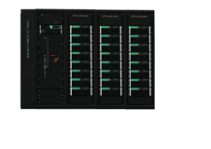
Optimised design
10kVA
25kVA
CMS-1200
CMS-50
CMS-100
CMS-150
CMS-250
CMS-350
CMS-500
CMS-800
50kVA
50KVA module, highest power density
one breaker system for cost efficiency

Slide 11
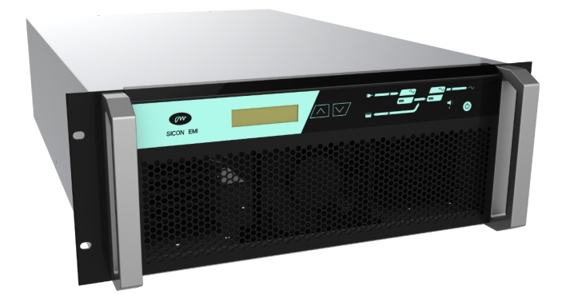
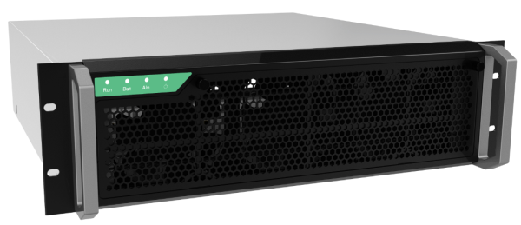
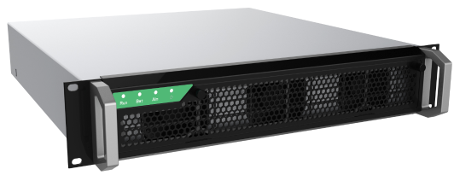
Rational redundancy
Power Module: 50 kVA（4U）
System Capacity: 350, 500, 800kVA, 1200kVA
Power Module: 25 kVA（3U）System Capacity: 150, 250 kVA
1200
Power Module: 10 kVA（2U）
System Capacity: 50, 100 kVA
3 UPS modules, 8 frames
50
Rational Redundancy, 4+1, 8+2, 12+3 (advised redundancy rate around 10%~20%)

Slide 12
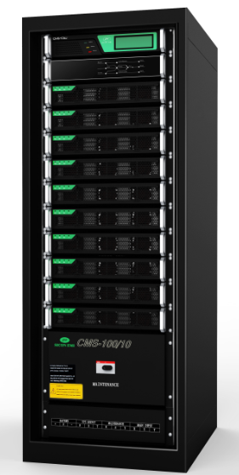
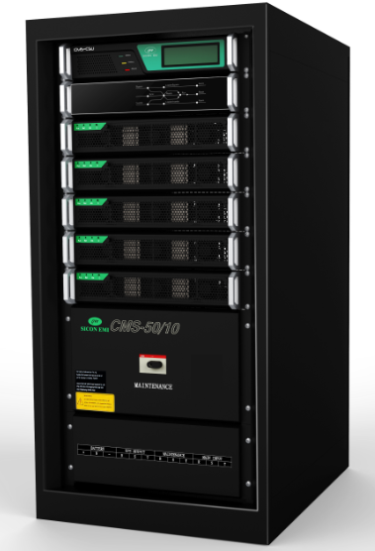
CMS model
CM10 UPS module
CMS-50KVA
CMS-100KVA
5 module rack, 50KVA
600(W)*800D*1200(H)
10 module rack, 100KVA
600(W)*800D*1600(H)

Slide 13
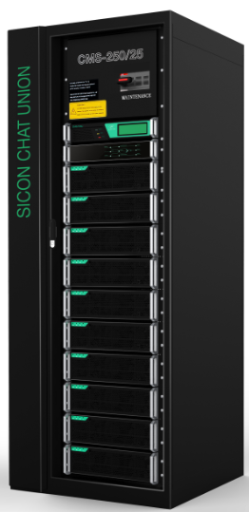
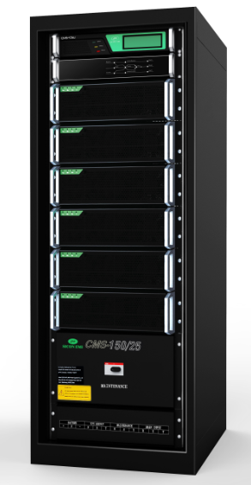
CMS model
CM25 UPS module
CMS-150KVA
CMS-250KVA
6 module rack, 150KVA
600(W)*800D*1600(H)
10 module rack, 250KVA
800(W)*800D*2000(H)

Slide 14
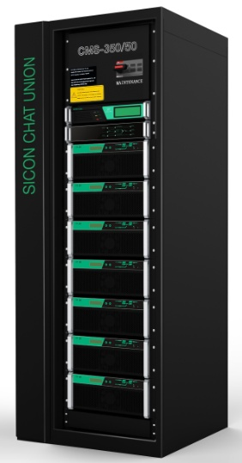



CM50 UPS module
CMS-350KVA
7 module rack, 350KVA
800(W)*1000D*2000(H)
CMS-800KVA
CMS-500KVA
16 module rack, 800KVA
2200(W)*1000D*2000(H)
10 module rack, 500KVA
1400(W)*10000D*2000(H)
CMS-1200KVA
24 module rack, 1200KVA
2800(W)*1000D*2000(H)

Slide 15

Power Extension
4800
1200kVA
1200kVA
1200kVA
1200kVA
Achieve up to 4800KVA
via 4 x 1200kVA parallel

Slide 16
modular UPS design concept&datacenter power supply solution
modular UPS power supply
standard power supply system
modular redundant structure

Slide 17
CMS
rack independent UPS
Applciation：System integrators, SKD, Cabinet manufacturer, Small and medium-sized data center
To facilitate in-row UPS rack solutions, SCU has designed the CMS Rack independent UPS. It is a modular UPS including base unite, sub module frame, and UPS modules that fits into any 600x1000mm 19 inch rack. Starting at 25kVA up to 200kVA this solution is easy to integrate into small and medium size computer room designs. This UPS solution enables you to integrate the full UPS into a HOT-COLD Corridor design of any particular brand.

Slide 18



CMS rack independent UPS model
CMS/PDM-100
system capacity: 100KVA
sub module frame capacity: 100KVA
UPS module capacity: 25KVA
21U
CMS/PDM-200
system capacity: 200KVA
sub module frame capacity: 100KVA
UPS module capacity: 25KVA
40U
CMS/PDM-50
system capacity: 50KVA
sub module frame capacity:50KVA
UPS module capacity: 25KVA
15U

Slide 19





product components
power module
base unit
sub module frame

Slide 20


base unit
RU-CMS100/25 base unit
- Input/ Output cable entries
- STS static switch 100kVA
- Maintenance By-Pass switch
- System monitoring (placed on eye height)
- Maximum size supported 100kVA/90kW
- input/output 3/3, 3/1, 1/3, 1/1
- 380/220VAC, 400/230VAC, 415/240VAC, 50/60Hz
- SNMP interfacing
- fits into any 19inch frame
- Height Base Unit is 9U
RU-CMS200/25 base unit
- Input/ Output cable entries
- STS static switch 200kVA
- Maintenance By-Pass switch
- System monitoring (placed on eye height)
- Maximum size supported 200kVA/180kW
- input/output 3/3, 3/1, 1/3, 1/1
- 380/220VAC, 400/230VAC, 415/240VAC, 50/60Hz
- SNMP interfacing
- fits into any 19inch frame
- Height Base Unit is 16U

Slide 21


sub module frame
RU-CMS MSF2 sub module frame
- Fits up to 2x 25kVA/22,5kW UPS modules
- maximum size 50kVA per CM/A50F
- maximum 1 MSF2 with RU-CMS100/25 base unit
- fits into any 19inch frame
- Sub module frame height 6U total
RU-CMS MSF4 sub module frame
- Fits up to 4x 25kVA/22,5kW UPS modules
- maximum size 100kVA per CM-100F
- maximum 1 MSF4 with RU-CMS100/25 base unit
- maximum 2 MSF4 with RU-CMS100/25 base unit
- fits into any 19inch frame
- Sub module frame height 12U total

Slide 22
power module
CM-25 power module
- 25kVA/22.5kW UPS modules
- maximum 8 CM25 UPS modules per Rack-CMS200/25 base unit
- 3 phase input/output
- 400/230VAC, 50Hz
- dimension: 482*465*133(W*D*H)mm

Slide 23
Features
embedded standard cabinet
Online hot swappable
  all module online hot swappable, maintanance, expansion.
  embedded 19 inch cabinet, easy installation.
system redundant
Fault tolerance
  System with online expansion function, according to the load dynamic expansion, to ensure system redundancy
  power module share the load, with fault isolation function,great fault-tolerant
Flexible configuration
Tier 4 design
Multi output mode
  Configuration according to the actual need base module, UPS module rack, remaining space, batteries, transformers, PDU, etc.
  meet T4 degree demands even small datacenter
  Suitable for single phase or three phase load demands.

Slide 24
ERMS
series embedded modular UPS
Application: Small and medium power ICT room
ERMS series UPS is an embedded modular UPS of low and medium power developed by SICON. With flexible structure, it could be embedded in standard 19 inch cabinet or work independently for de-centralized power supply.
It features superb input and output performance indexes. As a product with the smallest size, the highest efficiency and the greatest power density in the industry, it boasts an extremely high cost-efficiency..

Slide 25





ERMS series UPS
system capacity: 12kVA、24kVA、36kVA, UPS module: 6kVA.
capacity: 36KVA
dimension: 480*600*310（W*D*H）
6kVA module (1/1 mode)
capacity: 24KVA
dimension: 480*600*220（W*D*H）
capacity: 12KVA
dimension: 480*600*132（W*D*H）
monitor

Slide 26



ERM-06 specification

Slide 27
DSP
series digital UPS
Application field: High power density data center, bank, security, vending machines system, Telecom/VoIP, etc..
DSP Series Rackmount UPS: High frequency On-line double conversion technology; Both of Rackmount and Tower are available. Parallel function: AC output could be worked in parallel. 1+1 redundancy in power module give protection on users’ data center.
Function: clean and persistent power supply, protect key equipment and Apps to be safe against shunt down, data loss and process interrupt which is caused by powerfail

Slide 28


capacity：10kVA/15kVA/20kVA
wire in/out mode: ：3/1、3/3
Rackmount / Tower
battery voltage：±240V（210~290）
charging power：2KW（4A）
dimension：430*615*132(W*D*H)

Slide 29


battery pack
Lithium battery pack
Features: High volume density and weight density,saving space, reducing line loss, safe and reliable. Standard specifications , 19” rack type.

Slide 30



DSP series UPS features
The host with main frame, vertical installation design for users free choice; rack installation, can be put into 19 inch standard network cabinet. only height 3U
Tower
Rackmount

Slide 31
DPJ
series modular Integration of power
distribution system
SICON DPJ series intelligent modular power distribution system (IMPDS) provides safe, manageable, scalable, maintenance input and output power distribution solution for UPS. We have Input & output IMPDS and output IMPDS. The IMPDS can real detect various index of the outlet optimize the cable management. The modular structure outlet switch supports online expansion and maintenance, and simplifies the installation and commission.

Slide 32

DPJ model
DPJ-160/200/250/300/400
system capacity：160A/200A/250A/300A/400A
dimension：600*1000*2000 W*D*H (mm)
weight: about 300kg

Slide 33
DPQ
series static transfer switch
DPQ series STS (Static Transfer Switch) solution provides an automatic, seamless transfer between your business-critical load and the outputs of two independent UPS Systems in a dual-bus power configuration.

Slide 34

DPQ series Static transfer switch
adopting AC contactor and SCR parallel transfer technology,transfer time less than 5ms

Slide 35


DPQ model
DPQ 33
system capacity：100A/160A/200A/250A/400A
dimension：600*800*1400W*D*H (mm)
DPQ 11
system capacity：10A/20A/32A
dimension：440*380*44 W*D*H (mm)

Slide 36




Features
input cabinet
input cabinet
Intelligent monitor, diagnostics and alarming
Priority source: the user chooses one source as main source and another as standby
Transfer time : 5ms maximum auto transfers between AC power sources
Protection: if the STS fail, the system will choose one input source as fix source, to ensure uninterruptible power supply
break-before-made switching, automatic switching
Manual and automatic transfers
mains
bypass
mains
bypass
STS
UPS
UPS
DPJ
device 1
deviceN

Slide 37
DHP
series rack inverter
Application: IT room, Intelligent management system, emergency lighting
DHP11 series inverter is DC-AC sine wave inverter. output power 1KVA, 2KVA, 3KVA. it is small size, light weight, high efficiency. with high power density, applicable for IT room, intelligent management system and emergency lighting. DC inout volatge 48VDC, 110VDC, 220VDC. single phase AC output . load could be Inductive load, conductive load.

Slide 38

DHP inverter components
capacity：1KVA/2KVA/3KVA
dimension：19”W*300D*1UH
DC input: 24V/48V/110/220VDC
AC output: 220VAC
single phase, with bypass
operation principle: mains input and DC input, master or standby.

Slide 39


DHP inverter Features
installation: height 1U putting in standard cabinet.
Control circuit: SPWM sine wave modulation, 16-bit microprocessor control.
input: Mains and Inverter output mainly among the reverse, the priority of both can be set by the user.
communication: RS232 、output dry contact ( representing bypass line, inverter online, battery alarm status).
MTBF(Mean Time Between Failure)> 100000h;
protection: AC input over-voltage and under-voltage protection, output over-voltage and under-voltage protection, overload and short-circuit protection, over-temperature protection, battery under-voltage warning, shutdown etc

Slide 40
DTP
series modular rack inverter
Application: Telecommunication station, electrical substation and environments with poor utility grid conditions.
DTP series modular Inverter is pure sine wave, single phase, DC-AC inverter for critical telecom and electric power equipments. The DC input could be 48VDC, 110VDC or 220VDC. It is modular architecture, consisting of system rack and inverter modules, which could configure various power capacities by adding modules. With N+1 redundant design, if one inverter fails, it will withdraw from the system and the inverter system keeps supply to load.

Slide 41




DTP models
system capacity: 9KVA
weight: about 23KG
system capacity: 18KVA
weight: about 25KG

Slide 42

Operation principle
The input of DTP stand-alone has two kinds: single-phase bypass and DC. The output is neither bypass or DC which is determined by the monitor (monitor can set priorities). All power units modules output in parallel.

Slide 43

DTP inverter Features
input DC voltage: 48V、110V、220V
modular design, power module and monitor module could be hot swappable.
Complete system protection which is input/output over-voltage and under-voltage protection, overload protection and so on
System superior switching function can be quickly converted in the synchronous and asynchronous situations.

Slide 44
SCU
SAFE & SAVE POWER
SCU ensures reliable flexible secured power with high efficiency (TUV certified) and unparalleled warranty conditions up to 5+5 year. A balanced advanced true modular electronic design using industrial grade components.
From component and raw steel sheets to the individually tested end product is all performed and controlled in the SCU factory. With more than 400 employees of which 80 are in the R&D department we offer a truly trustworthy and future-proof solution to all our customers worldwide.

Slide 45

advantages

Slide 46







Advantages
modular standardized components, shortening the period of on site construction and extension
Intelligent monitoring improves equipment reliability, reduces maintenance, improves maintenance efficiency
Easy installation
intelligent design
Standardized, efficient products, reducing data center construction, operation and maintenance costs
High efficiency design
Proven by independent body
TÜV Rheinland
Flat line up to 96.5% system efficiency
low TCO
Save energy
Hot-swap design, easy to maintenance and expansion, improved system availability; fault isolation design, greatly improving system reliability。
High quality
5 year warranty
Low maintenance
modular design
High Reliability

Slide 47








Applications
Medical
Finance
Education
Telecom
Retail
Production
Transportation
Aviation / Radar station
Applicable for small to large organizations for server rooms, mission critical systems and equipment, etc.

Slide 48
Advantages for our distributors
Exclusivity for country or territory
Direct support, possibility for special product development, direct line to factory through Eruopean headquarter in The Netherlands
Exclusivity
Flexibility
Clear European price strategy and protection.
Standard warranty fee per frame
Possibility for 5 year warranty including batteries!
Price Protection
5 Year Warranty
Direct delivery from China or from European stock in The Netherlands
Direct technical and commercial support and training from the European HQ. Including mobile showroom (trailer)
Direct delivery
Support

Slide 49
Business model
1
MODULAR
Modular UPS means easy configuration, flexibility and installation.
Modular UPS is a premium product
UPS
2
EXCLUSIVITY & PRICING
Pan-European fixed 3-TIER price strategy.
Distributor – Reseller - Enduser
UPS power distribution
No special spare parts needed!
Every electronic part is a hot-swappable standardized module.
Fixed warranty fee for up to 10 years
3
STOCK & SERVICE & SPARES
4
SUPPORT & FUTURE PROOF
Direct support from The Netherlands SCU team. Commercial and technical
Full inverter based product range.
DC Fast-chargers
Bidirectional storage power supply
AC charging station

Slide 50
SAVE & SAFE POWER
www.scupower.eu
Notes:
最后再给大家摆个早年！祝大家在新的一年里财源广进，恭喜发财！

